Slide 1
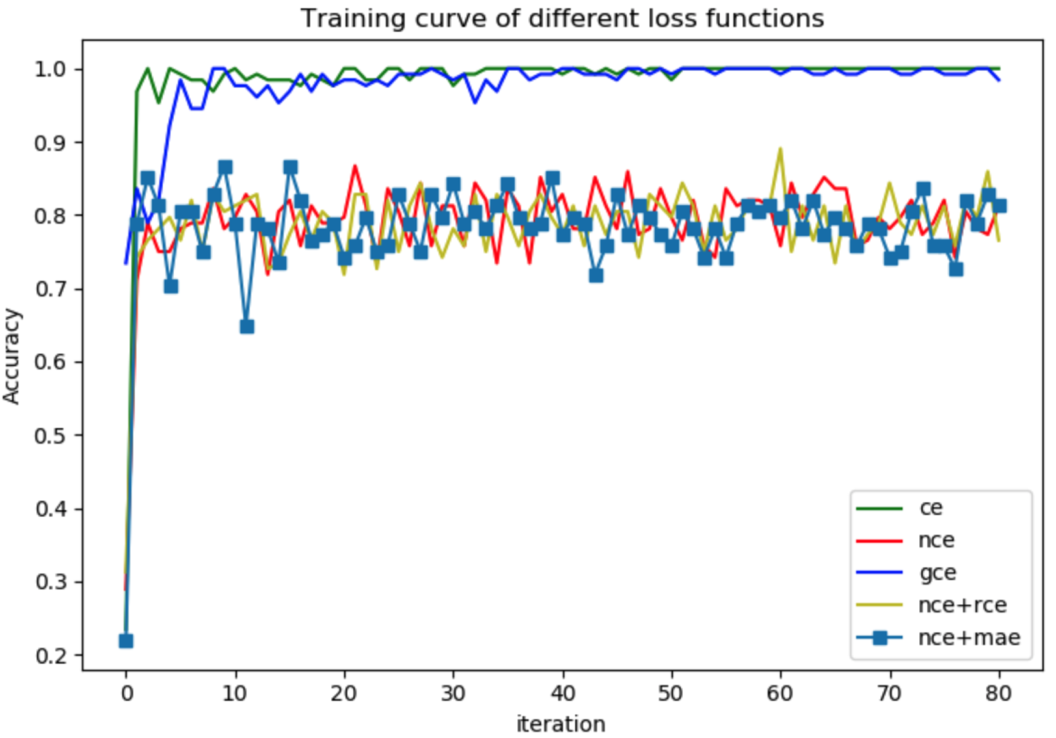

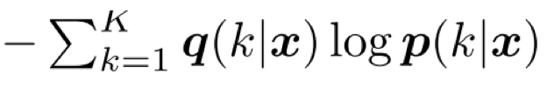
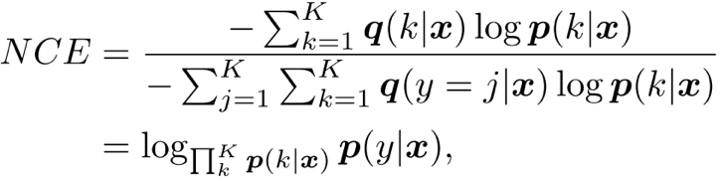


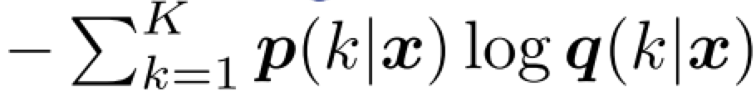
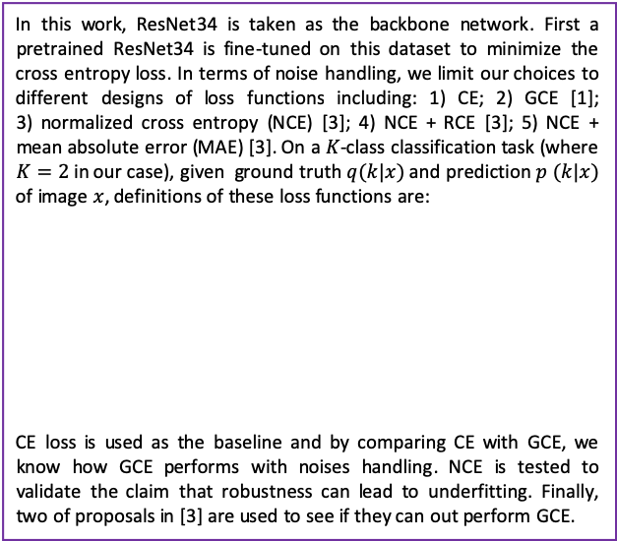
MATH 6380P Final-Project 1: Nexperia Image Classification II with Noise Handling
Huimin WU¹ {hwubl}@ust.hk
¹: 20669876, Department of Computer Science and Engineering, HKUST
1. Introduction
4. Methodology
6. Analysis
This work is to differentiate good semi-conductor from defect semi-conductors using deep learning techniques. Besides, considering that there are noisy labels in the dataset, i.e., some good semi-conductors are mislabeled as ”defect” and some defect semi-conductors are mislabeled as “good”, we also applied several state-of-the-art noise handling techniques to see if they could be able to improve the prediction performance, measured by Area-Under-the-Curve (AUC). At the same time, we are also interested in several claims in our reference work [3] so we evaluated different loss functions on this dataset to see whether or not they still hold.
In this work, ResNet34 is taken as the backbone network. First a pretrained ResNet34 is fine-tuned on this dataset to minimize the cross entropy loss. In terms of noise handling, we limit our choices to different designs of loss functions including: 1) CE; 2) GCE [1]; 3) ﻿normalized cross entropy (NCE) [3]; 4) NCE + RCE [3]; 5) NCE + mean absolute error (MAE) [3]. On a $K$-class classification task (where $K=2$ in our case), given ground truth $q(k|x)$ and prediction $p (k|x)$ of image $x$, definitions of these loss functions are:
CE loss is used as the baseline and by comparing CE with GCE, we know how GCE performs with noises handling. NCE is tested to validate the claim that robustness can lead to underfitting. Finally, two of proposals in [3] are used to see if they can out perform GCE.
From the experimental results we can see that the proposals in [3] including NCE, NCE+RCE, NCE+MAE, do not work well on this dataset and can not be properly trained as shown above. One possible reason is that above models are all fine-tuned from a pre-trained model, which is already overfitting to noises. So we also tried to train NCE from scratch but now training accuracy is dropped from 0.84375 (training using a pretrained ResNet34) to 0.74219. Another possible reason is that hyperparameters should be carefully tuned, which would be left to the future work.
2. Semi-conductor image classification 2 mini dataset
The whole dataset contains 34459 semi-conductor images in the training set and 3830 images for test. Among the training images, 27420 are good semi-conductors and the rest 7039 are defect. On this dataset, label noises exist but we make no assumptions on noisy rate, which are unavailable to us.
3. Classification with noise handling
Deep neural networks are able to give precise prediction for a variety of computer vision tasks such as classification, segmentation and detection, even when the labels are incorrect. In other words, they can fit not only clean labels but also noisy labels, leading to a poor generalization ability.
Cross entropy (CE) loss, a widely used loss function for classification has been proven to be not robust to noises, so several extension works are proposed such as generalized cross entropy (GCE) loss[1] and reverse cross entropy (RCE) [2] to improve its robustness to noisy labels.
In [3], the authors claim that after normalization, any loss function can be robust to noises but it is not enough because robustness would cause underfitting problem. On solution to that problem is to combine two loss functions, one active, robust loss to maximize the output probability at the label class position and the other passive, robust loss to minimize the output probability at other class positions so that they can be a mutual boost to each other.
5. Experimental results
7. References
Loss function | AUC
CE | 0.99766
GCE [2] | 0.99782
NCE [3] | 0.43710
NCE+RCE [3] | 0.50803
NCE+MAE [3] | 0.56423
[1] Zhang, Z. and Sabuncu, M., 2018. Generalized cross entropy loss f1r training deep neural networks with noisy labels. Advances in neural information processing systems, 31, pp.8778-8788.
[2] Wang, Y., Ma, X., Chen, Z., Luo, Y., Yi, J. and Bailey, J., 2019. Symmetric cross entropy for robust learning with noisy labels. In Proceedings of the IEEE International Conference on Computer Vision (pp. 322-330).
[3] Ma, X., Huang, H., Wang, Y., Romano, S., Erfani, S. and Bailey, J., 2020, November. Normalized loss functions for deep learning with noisy labels. In International Conference on Machine Learning (pp. 6543-6553). PMLR.

